Slide 1


INTEGRATED CAPSTONE PROJECT
INTEGRATED CAPSTONE PROJECT
PROJECT NAME : Marketing for Financial
Services
BATCH : H
GROUP : H1
PROJECT NAME : Marketing for Financial Services
Sri Praveena Geddam(DELBC8001)
Hebbar Sumukh(DELBC8002)
Niyatee Nibedita Panda(DELBC8003)
Yogam Rakshana R(DELBC8004)
Ukash Bhat(DELBC8005)
BATCH : H
GROUP : H1
BY:
Sri Praveena Geddam(DELBC8001)
Hebbar Sumukh(DELBC8002)
Niyatee Nibedita Panda(DELBC8003)
Yogam Rakshana R(DELBC8004)
Ukash Bhat(DELBC8005)

Slide 2



Problem Statement
DB Bank is a large public sector bank which has branches across the cities. It provides various services like savings accounts, current account, term deposits, personal loans, home loans etc. to customers. Whenever the bank conducts marketing on its new schemes, it will keep track of data related to customers’ personal, social and economic details. Also, it maintains the detailing on efforts made to achieve success in the campaign.
Recently, the bank has conducted a campaign to market their term-deposit scheme. Campaigns was conducted based mostly on direct phone calls, soliciting the bank's customers to place a term deposit. After all the marking efforts, if the client had agreed to place a deposit, then the campaign is success, otherwise not.
The campaign success is needed to be measured based on appropriate predictive model for classifying successful and unsuccessful campaign.

Slide 3



CHALLENGE
SOLUTION
It is a challenge for bank officials to target right people for a successful campaign.
The marketing team must analyse various details like profession, income, age, education including the possibility of any existing loans, credit history etc will give economic status of the customer and hence helps in understanding whether the person is capable of depositing money into term-deposit scheme of the bank.
A Predictive Model for classifying data can be built, to efficiently analyze the data and ascertain the right target audience

Slide 4


Data Dictionary
Data related to the last contact of the current campaign
Bank Client Data
Customer id : Unique customer id
custAge: Age of the customer.
profession: type of job
marital: marital status
schooling: Educational qualification
default: has credit in default?
housing: has housing loan?
loan: has personal loan?
State_Code: Code representing unique state name
Region_Code: Code representing unique Region name
City_Code: Code representing City of the customer
Postal_Code: Postal code of the area
contact: contact communication type
month: last contact month of year
day_of_week: last contact day of the week
campaign: number of contacts performed during this campaign and for this client
pdays: number of days that passed by after the client was last contacted from a previous campaign
poutcome: outcome of the previous campaign
Social and Economic context attributes
emp.var.rate: employment variation rate - quarterly indicator
cons.price.idx: consumer price index - monthly indicator
cons.conf.idx: consumer confidence index - monthly indicator
euribor3m: euribor 3 month rate - daily indicator
nr.employed: number of employees-quarterly

Slide 5
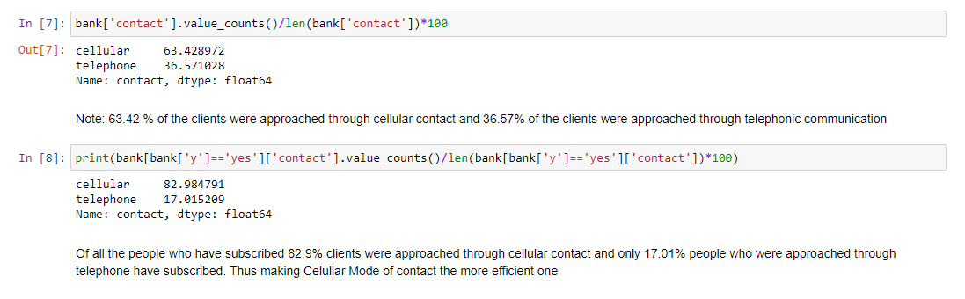
Task 1.1 – Data Manipulation using Python
CHECKPOINT - 1
Right Mode to contact the customers (Telephone or Mobile)

Slide 6
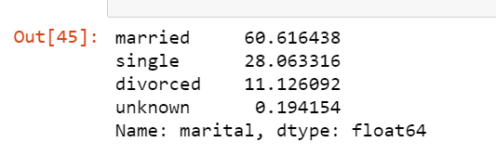
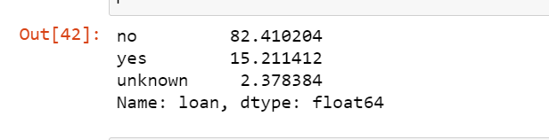
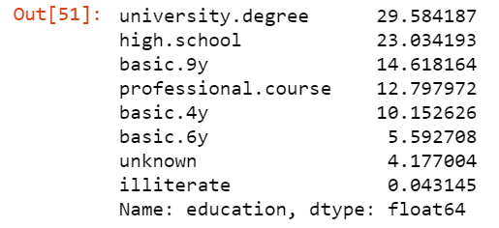
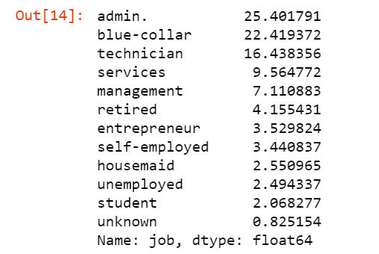
Personal data analysis on marital status, existing loans, education, profession etc. and its impact on campaign’s success
Percentage Analysis of Marital Status
Percentage Analysis of existing loans
Percentage Analysis of Education
Percentage Analysis of Profession

Slide 7
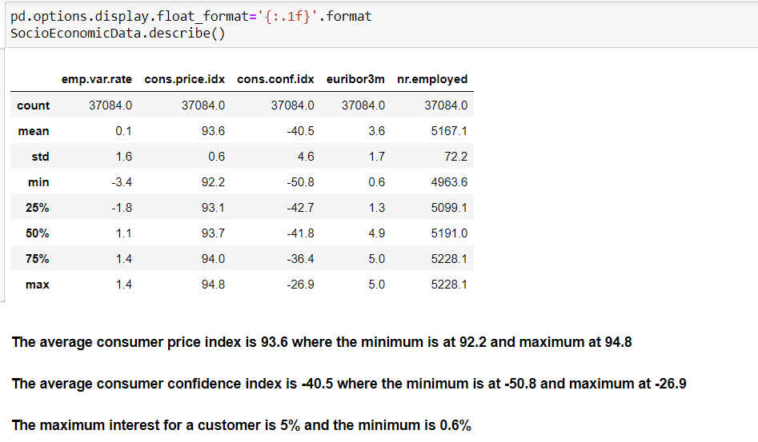
Socio-Economical analysis of the customers

Slide 8
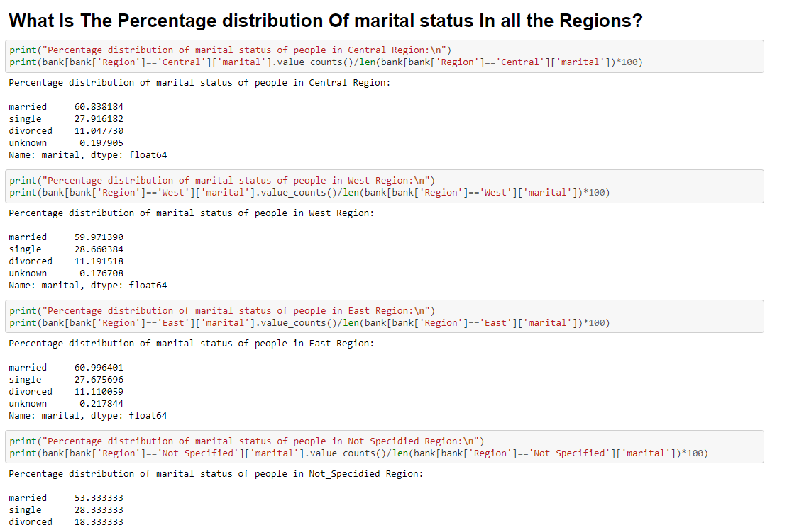
Demographic analysis of the marketing campaign using the master files

Slide 9
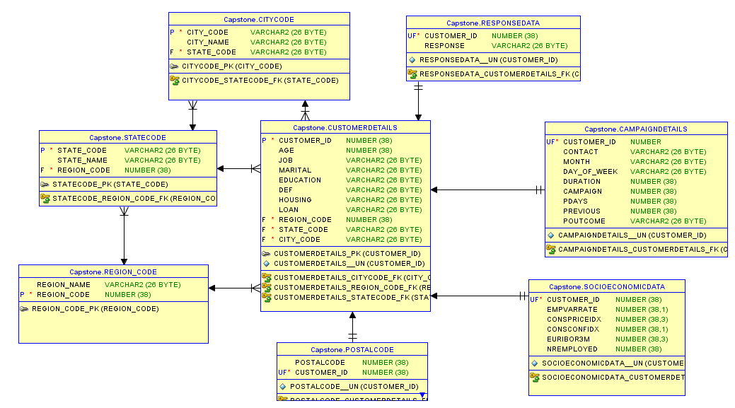
TASK 1.2 – SQL – Oracle
Construct an ER-Diagram
The "customerdetails" has "Many to One" relationship with "citycode" , "statecode" and "region_code" tables.
The "responsedata" , "campaigndetails" , "socioeconomicdata" and "postalcode" tables have "One and Only One" relationship with the "customerdetails" table.

Slide 10
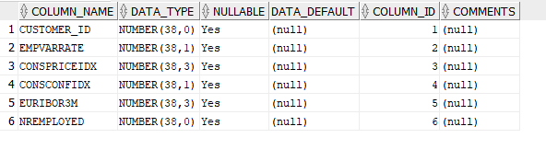
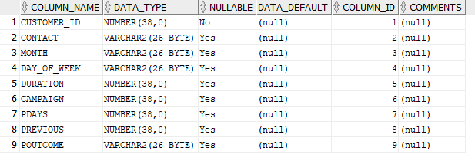
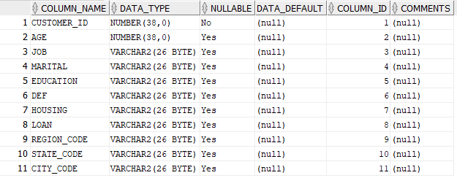
Creation of tables as per ER-Diagram
Socio-economic Data Table
Campaign Details Table
Customer Details Table

Slide 11
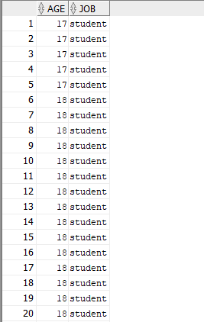
Generate the list of customer has per age and profession and display them according to ascending order of the age.
Selecting “AGE”, “JOB” columns from the table CUSTOMERDETAILS order by “AGE” to get the output in ascending order.

Slide 12
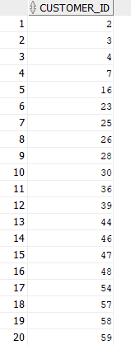
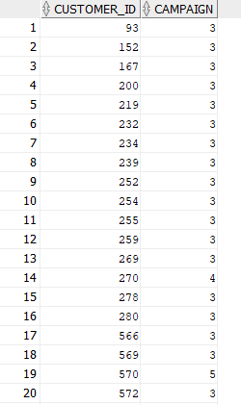
Generate the list of customer who have no housing loan and personal loan.
Generate the list of customer who has credit and has been contacted more than 2 times during the campaign.
Selecting the list of customers (column : “customer_id”) who have no housing loan or personal loan.
Selecting the “customer_id”, “default1”, “campaign” rows from the joint table of customerdetails and campaigndetails with the above stated conditions.

Slide 13
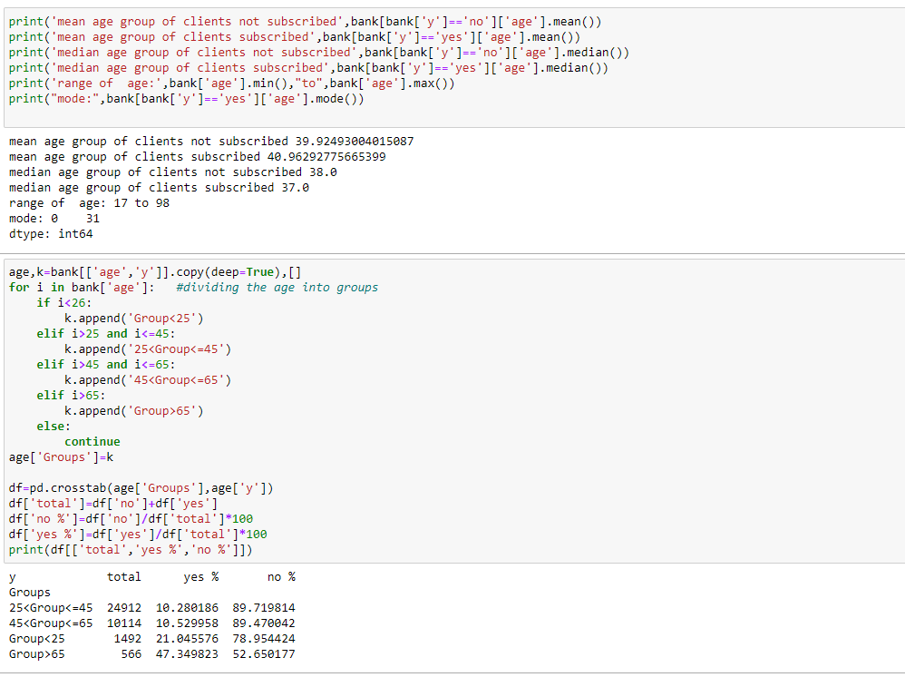
TasK 1.3 – Statistical Analysis using Python
Descriptive statistics for both numerical and categorical and draw few insights from them.

Slide 14
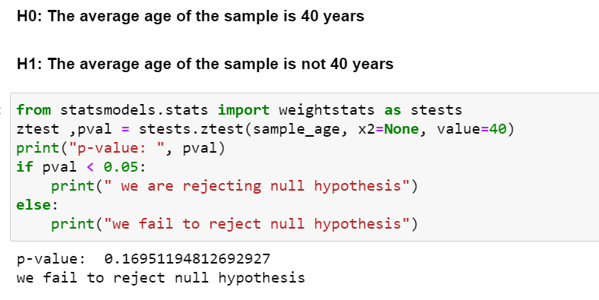
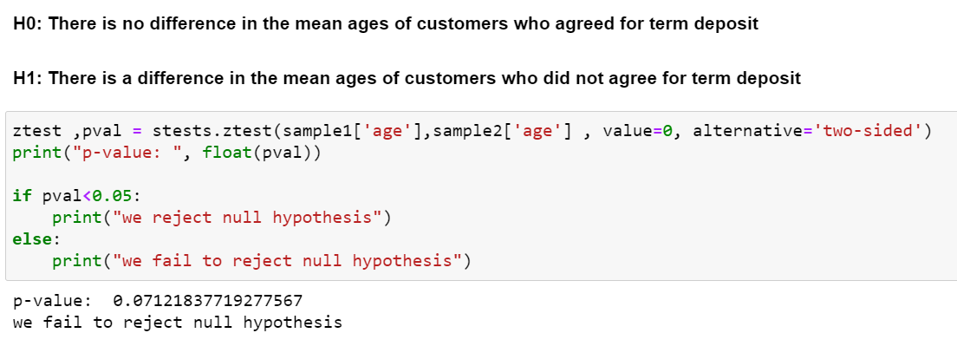
Perform relevant hypothesis testing (z test, chi-Square)
One Sample Z-test
Two Sample Z-test

Slide 15
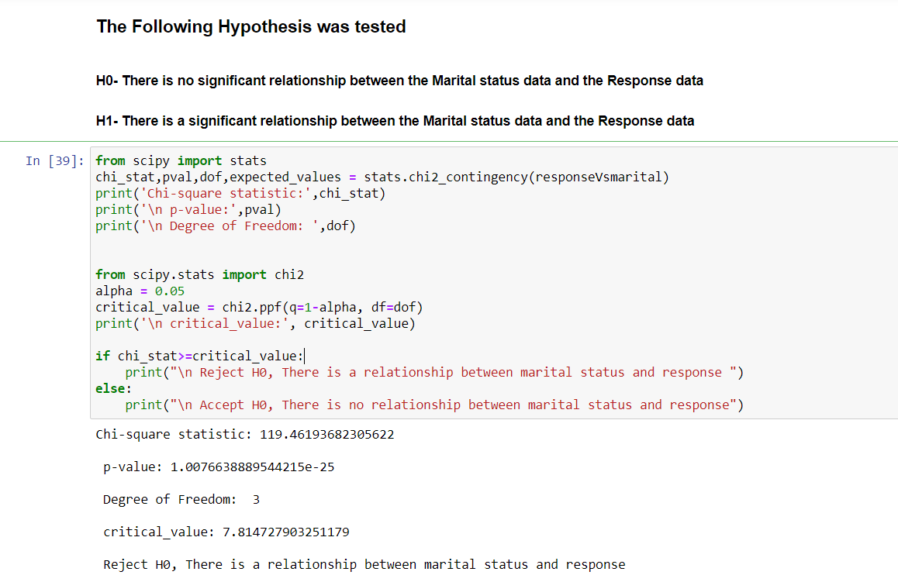
Chi-Square Hypothesis Test

Slide 16


